Slide 1

Reporting and Analyzing Long-Term Liabilities
10
Chapter
UAA – ACCT 201 Principles of Financial Accounting Dr. Fred Barbee

Slide 2

IS FUN!
ACCT 201
Chapter 10
Day One

Slide 3
Chapter 10 - Day 1 - Agenda
Topic | LO | Read | HW
Basics of Bonds | A1, C1 | 422-425 | QS1
Bond Issuances | P1, P2, P3 | 425-436 | E1,2,3, 4,5,6; P1
Present Value of Bonds and Notes | C3, C4 | 445-448 | None
No Homework Due Today!

Slide 4
Basics of Bonds
Bond

Slide 5



Basics of Bonds
Bond Selling Price
Bond Certificate
at Par Value
Company
Investors
Bond Issue Date
ACCT 201 ACCT 201 ACCT 201
Notes:
2
2

Slide 6
Basics of Bonds
Bond Interest Payments
Company
Investors
Bond Interest Payments
Interest Payment = Bond Par Value x Stated Interest Rate
Bond Issue Date
ACCT 201 ACCT 201 ACCT 201
Notes:
2
2

Slide 7
Basics of Bonds
Bond Par Value at maturity date
Company
Investors
Bond Maturity Date
Bond Issue Date
ACCT 201 ACCT 201 ACCT 201
Notes:
2
2

Slide 8
Advantages of Bonds
Bonds do not affect owner control.
Interest on bonds is tax deductible.
Bonds can increase ROE.
Bond

Slide 9
Disadvantages of Bonds
Bonds require periodic payment of interest.
Bonds require payment of principal at maturity.
Bonds can decrease ROE.
Bond

Slide 10
Convertible and Callable
Types of Bonds
Secured and Unsecured
Registered and Bearer
Term and Serial

Slide 11

Bond Trading
Bond market values are expressed as a percent of their par value.
ACCT 201 ACCT 201 ACCT 201

Slide 12
Bond Issuances
Bond

Slide 13


Bond Issuing Procedures
An investment firm called an underwriter.
A company sells the
bonds to. . .
The underwriter sells the bonds to . . .
A trustee monitors the bond issue.
. . . investors

Slide 14
Interest Rates and the Issue Price

Slide 15
The Market Rate . . .
The rate of interest currently being demanded in the market, i.e., the rate that investors expect to earn on their investment.

Slide 16

The Market Rate . . .
The market rate is often referred to by other terms . . .
  The Effective Rate
  The Yield

Slide 17
The Market Rate . . .
The rate used to compute the present values of the two components of the price of a bond:
  The Present Value of the interest payments; and
  The Present Value of the face value at maturity.

Slide 18
The Contract Rate . . .
The interest rate specified on the face of the bond and in the bond indenture.

Slide 19
The Contract Rate . . .
The contract rate is often referred to by other names:
  The Stated Rate
  The Nominal Rate
  The Coupon Rate

Slide 20
The Contract Rate . . .
The contract rate is used only to calculate the amount of interest to be paid to the bondholders at each interest period.

Slide 21
Interest Rates and the Issue Price
What Determines the Market Rate?

Slide 22
The Market Rate . . .
In most cases the market price of bonds is influenced by . . .
  The riskiness of the bonds; and
  The interest rate at which the bonds are issued.

Slide 23

Riskiness of the Bonds
The risk factor is a combination of:
  The general economic conditions; and
  The financial status of the company selling the bonds,
    Moody’s, or
    Standard and Poors

Slide 24
Interest Rate on the Bonds
The interest rate on the bonds is primarily determined by the riskiness of the bonds . . .
  The higher the risk,
  The higher the interest rate.

Slide 25
Issuing Bonds Payable
What Determines the Issue Price?

Slide 26
Issuing Bonds Payable
When issuing bonds payable, there are three possibilities. Bonds may be issued . . .
  At face value (par);
  At a discount (less than par); or
  At a premium (greater than par).

Slide 27
Bonds Issued at Face Value
If the market rate is equal to the contract rate, the bonds will sell at face value (i.e., at par).
Notes:
Bonds Issued at Par
Why????
Because the investor wants the same interest rate the company is agreeing to pay.

Slide 28
Market Rate = Contract Rate
Issuing Bonds Payable
Effective
Coupon
Market
Contract
Yield
Nominal
12%
12%
Face Value
Bonds will sell at
ACCT 201 ACCT 201 ACCT 201
Notes:
Bonds Issued at a Premium
Why??
Because the company is promising to pay a higher rate than the investors are seeking at the time.

Slide 29
Bonds Issued at a Discount
If the market rate is higher than the contract rate, the bonds will sell at a discount (less than face value).
Notes:
Bonds Issued at a Discount
WHY???
Because the investors desire a higher rate than the company is promising to pay.

Slide 30
Market Rate > Contract Rate
Issuing Bonds Payable
Effective
Coupon
Market
Contract
Yield
Nominal
16%
12%
Discount
Bonds will sell at a
ACCT 201 ACCT 201 ACCT 201
Notes:
Bonds Issued at a Premium
Why??
Because the company is promising to pay a higher rate than the investors are seeking at the time.

Slide 31
Bonds Issued at a Premium
If the market rate is lower than the contract rate, the bonds will sell at a premium (more than face value)
Notes:
Bonds Issued at a Premium
Why??
Because the company is promising to pay a higher rate than the investors are seeking at the time.

Slide 32
Market Rate < Contract Rate
Issuing Bonds Payable
Effective
Coupon
Market
Contract
Yield
Nominal
10%
12%
Premium
Bonds will sell at
ACCT 201 ACCT 201 ACCT 201
Notes:
Bonds Issued at a Premium
Why??
Because the company is promising to pay a higher rate than the investors are seeking at the time.

Slide 33
Example #1
Bonds Issued At Par Value

Slide 34
Issuing Bonds at Par
Par Value = $1,000,000
Stated Interest Rate = 10%
Market Interest Rate = 10%
Interest Dates = 6/30 & 12/31
Bond Date = Jan. 1, 2002
Maturity Date = Dec. 31, 2021 (20 years)
Notes:
11

Slide 35
Bonds Issued at Face Value
If the market rate is equal to the contract rate, the bonds will sell at face value (i.e., at par).
Notes:
Bonds Issued at Par
Why????
Because the investor wants the same interest rate the company is agreeing to pay.

Slide 36
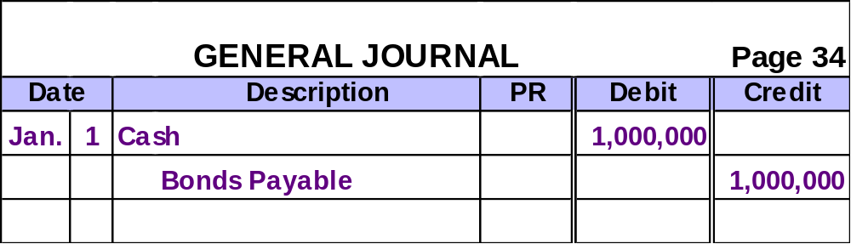
Issuing Bonds at Par
The journal entry to record the issuance of bonds at par.
ACCT 201 ACCT 201 ACCT 201
Notes:
12

Slide 37
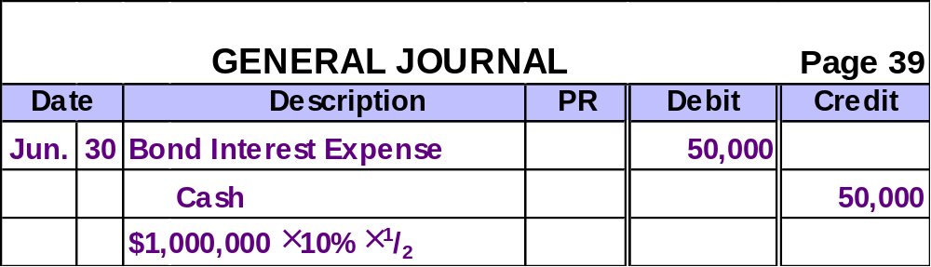
Issuing Bonds at Par
The journal entry to record the six-month interest payment on June 30.
This entry will be made every six months until the bonds mature.
ACCT 201 ACCT 201 ACCT 201
Notes:
13

Slide 38
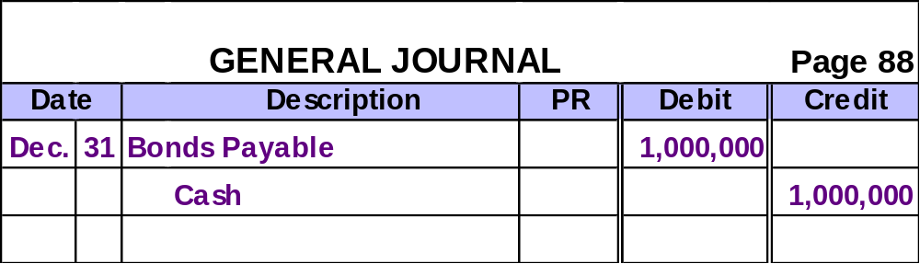
Issuing Bonds at Par
On Dec. 31, 202, when the bonds mature, the following entry would be made.
ACCT 201 ACCT 201 ACCT 201
Notes:
13

Slide 39
Example #2
Bonds Issued at A Discount

Slide 40
Issuing Bonds at a Discount
Par Value = $1,000,000, 5 Years
Issue Price = 92.6405% of par value
Stated Interest Rate = 10%
Market Interest Rate = 12%
Interest Dates = 6/30 & 12/31
Bond Date = Jan. 1, 2002
Maturity Date = Dec. 31, 2006

Slide 41
Bonds Issued at a Discount
If the market rate is higher than the contract rate, the bonds will sell at a discount (less than face value).
Notes:
Bonds Issued at a Discount
WHY???
Because the investors desire a higher rate than the company is promising to pay.

Slide 42
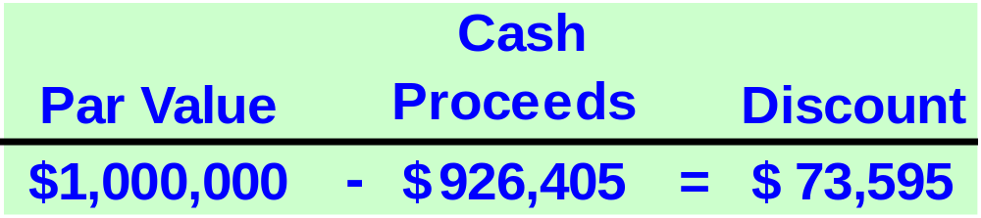
Issuing Bonds at a Discount
$1,000,000 × 92.6405%
Amortizing the discount increases Interest Expense over the outstanding life of the bond.
ACCT 201 ACCT 201 ACCT 201

Slide 43
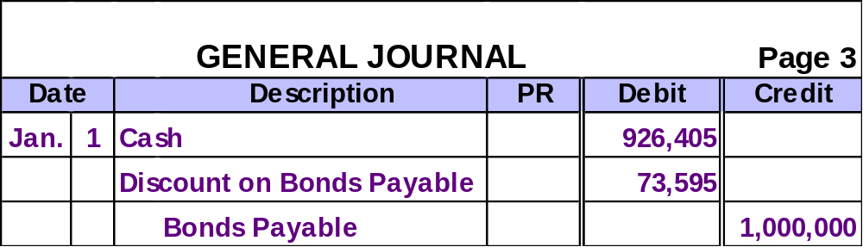
Issuing Bonds at a Discount
On Jan. 1, 2002, the bond issue would be recorded as follows.
Contra-Liability
Account
ACCT 201 ACCT 201 ACCT 201

Slide 44
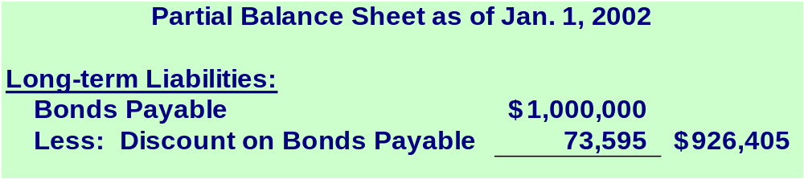
Issuing Bonds at a Discount
Maturity Value
Carrying Value
ACCT 201 ACCT 201 ACCT 201

Slide 45
Issuing Bonds at a Discount
Using the straight-line method, the discount amortization will be $7,360 every six months.
$73,595 ÷ 10 periods = $7,360 (rounded)
ACCT 201 ACCT 201 ACCT 201

Slide 46
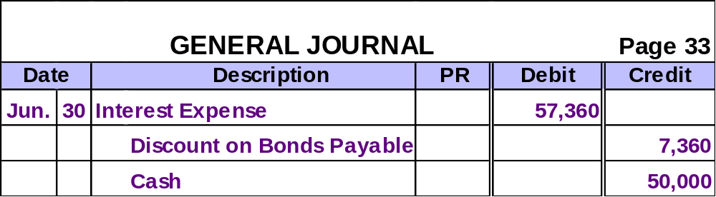
Issuing Bonds at a Discount
This entry will be made every six months to record the interest payment and the amortization of the discount.
$73,595 ÷ 10 periods = $7,360 (rounded)
$1,000,000 × 10% × ½ = $50,000
ACCT 201 ACCT 201 ACCT 201

Slide 47
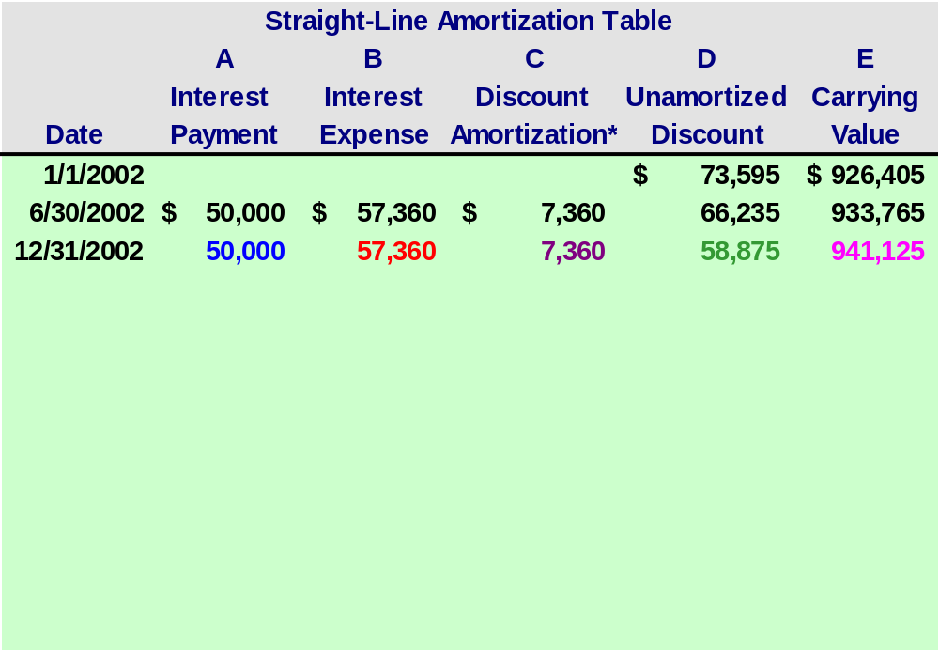
$1,000,000 x 10% x 1/2
$73,595/10 = $7,360 (rounded)
$50,000 + $7,360
$66,235 - $7,360
$1,000,000 - $58,875

Slide 48
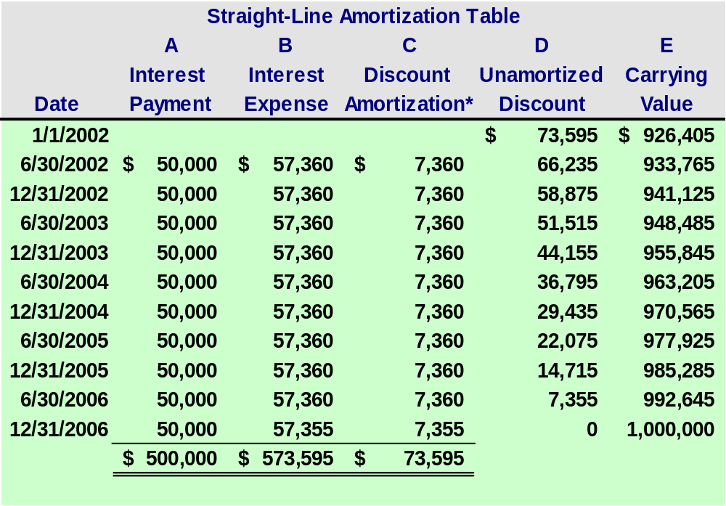

Slide 49

What if the company used the effective interest method to amortize the discount?
ACCT 201 ACCT 201 ACCT 201

Slide 50

Effective Interest Method
The effective interest method allocates bond interest expense over the life of the bonds in a way that yields a constant rate of interest.

Slide 51
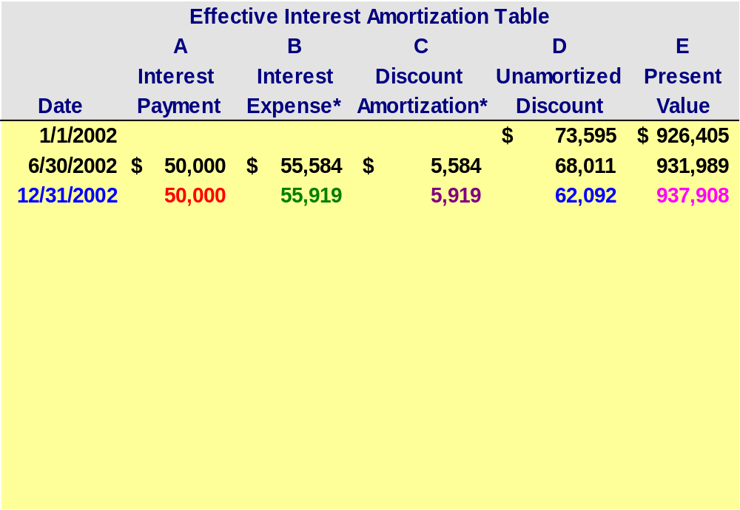
$1,000,000 x 10% x 1/2
$55,919 - $50,000
$931,989 x 12% x 1/2
$68,011 - $5,919
$1,000,000 - $62,092; or $931,989 + $5,919

Slide 52
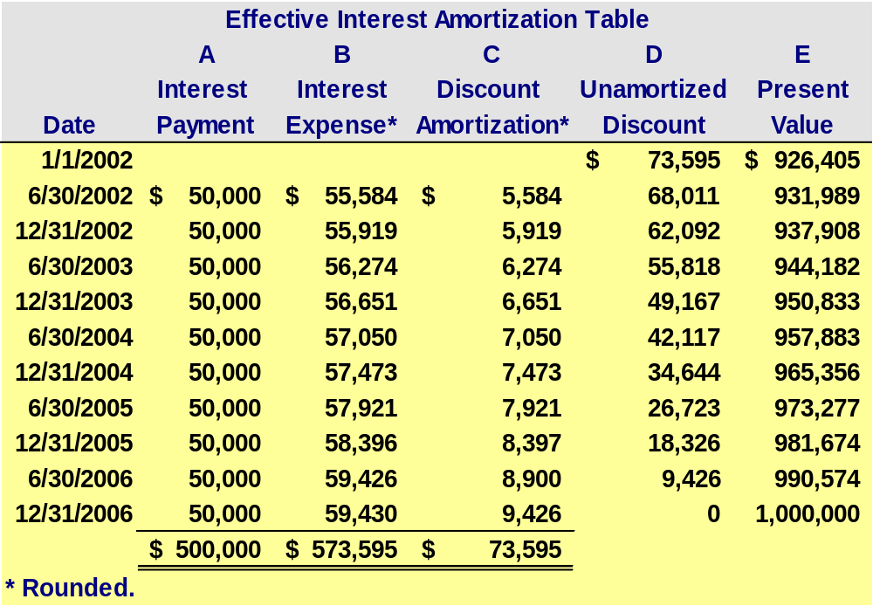

Slide 53
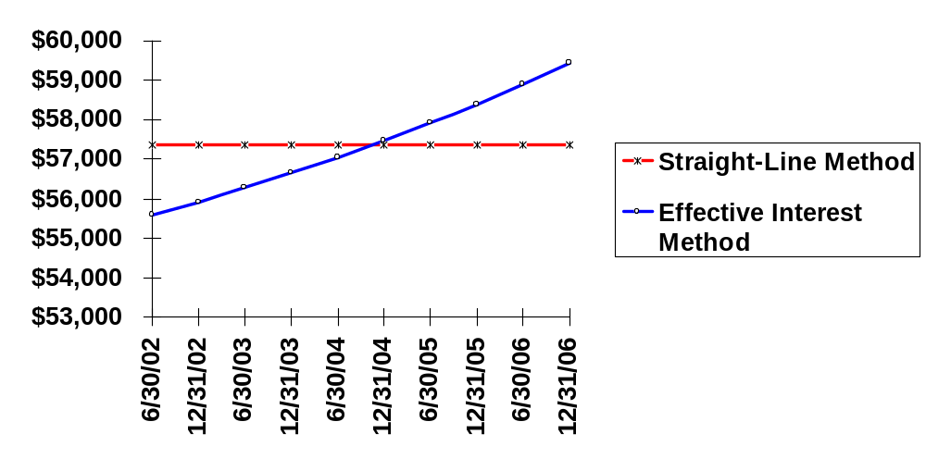
Comparing Straight-Line and Effective Interest Methods
Both methods report the same amount of interest expense over the life of the bond.
Annual Interest Expense

Slide 54
Example #3
Bonds Issued at A Premium

Slide 55
Issuing Bonds at a Premium
Par Value = $1,000,000
Issue Price = 108.1145% of par value
Stated Interest Rate = 10%
Market Interest Rate = 8%
Interest Dates = 6/30 & 12/31
Bond Date = Jan. 1, 2002
Maturity Date = Dec. 31, 2006 (5 years)

Slide 56
Bonds Issued at a Premium
If the market rate is lower than the contract rate, the bonds will sell at a premium (more than face value)
Notes:
Bonds Issued at a Premium
Why??
Because the company is promising to pay a higher rate than the investors are seeking at the time.

Slide 57
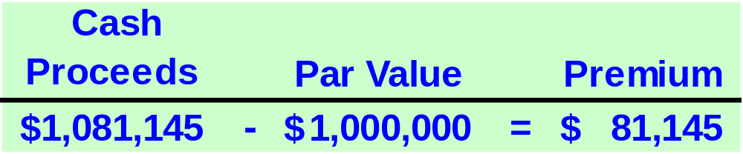
Issuing Bonds at a Premium
$1,000,000 × 108.1145%
Amortizing the premium decreases Interest Expense over the outstanding life of the bond.
ACCT 201 ACCT 201 ACCT 201

Slide 58
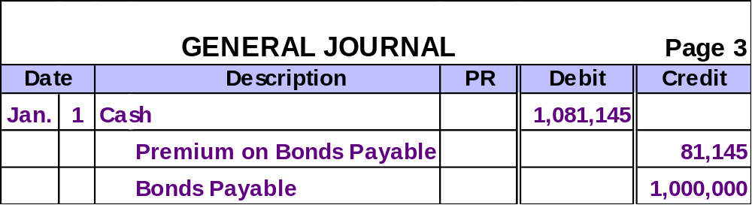
Issuing Bonds at a Premium
On Jan. 1, 2002, the company would record the bond issue as follows.
Adjunct-Liability
Account
ACCT 201 ACCT 201 ACCT 201

Slide 59
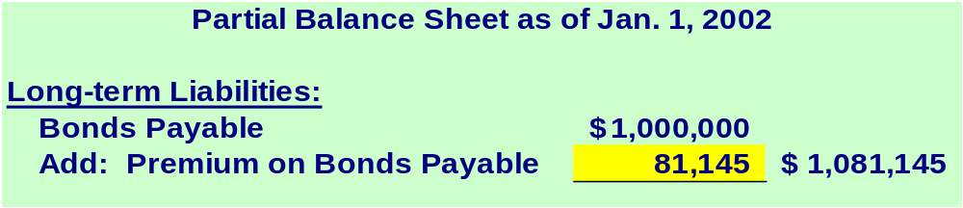
Issuing Bonds at a Premium
Using the straight-line method, the premium amortization will be $8,115 every six months.
$81,145 ÷ 10 periods = $8,115 (rounded)
ACCT 201 ACCT 201 ACCT 201

Slide 60
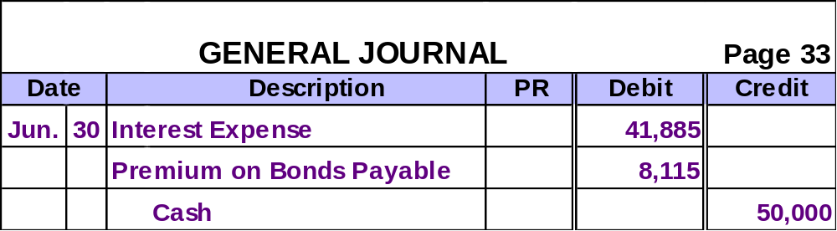
Issuing Bonds at a Premium
The semiannual interest payment over the life of the bonds.
$81,145 ÷ 10 periods = $8,115 (rounded)
$1,000,000 × 10% × ½ = $50,000
ACCT 201 ACCT 201 ACCT 201

Slide 61
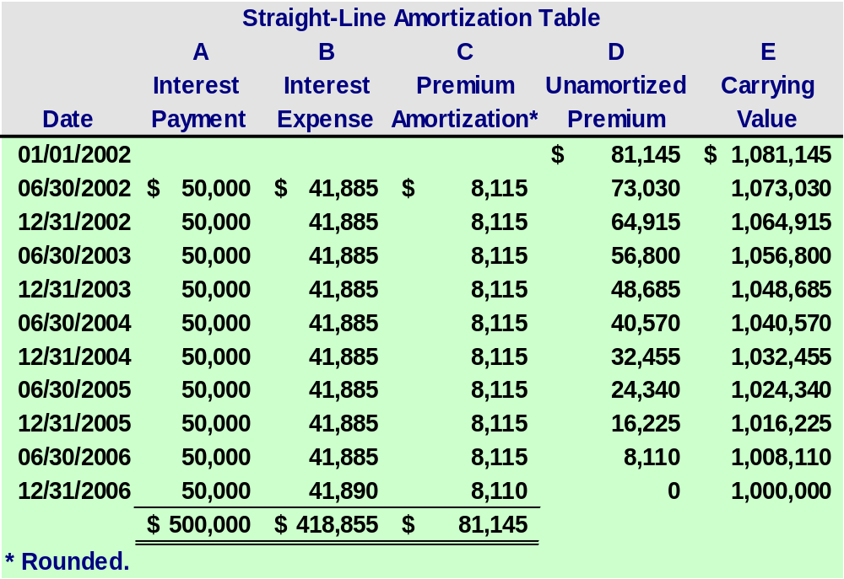

Slide 62
Let’s look at the effective interest method amortization table for this bond.
ACCT 201 ACCT 201 ACCT 201

Slide 63
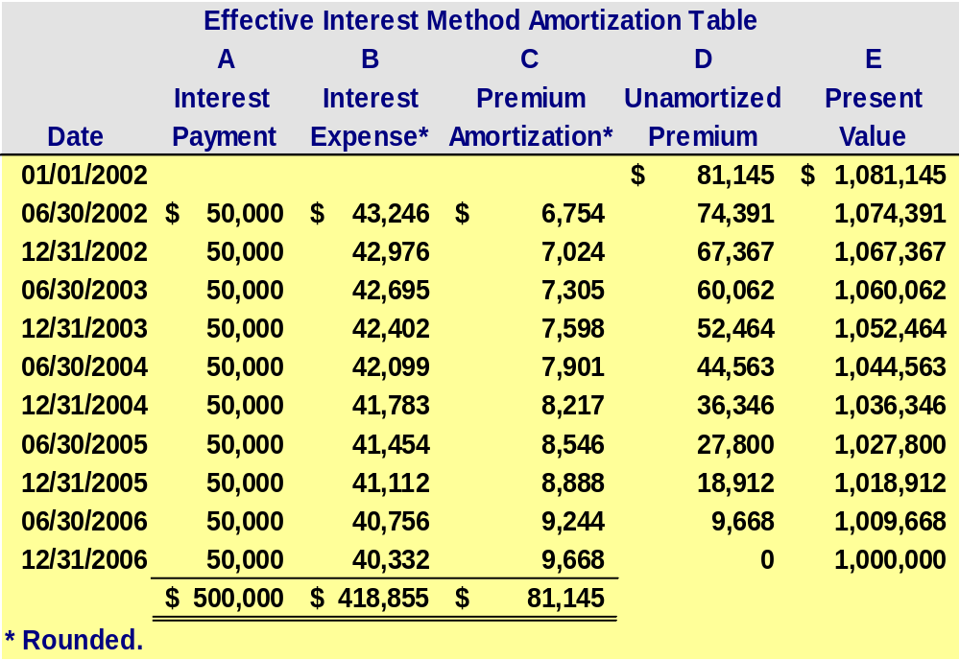

Slide 64
Issuing Bonds Between Interest Dates
Apr. 1, 2002
June 30, 2002
Jan. 1, 2002
Bond Issue Date
First Interest Payment
Bond Date
Accrued interest
Earned interest
Investor pays bond purchase price plus accrued interest.
Investor receives 6 months’ interest.

Slide 65
Issuing Bonds Between Interest Dates
Par Value = $1,000,000
Stated Interest Rate = 10%
Market Interest Rate = 10%
Interest Dates = 6/30 & 12/31
Bond Date = Jan. 1, 2002
Maturity Date = Dec. 31, 2006 (5 years)

Slide 66
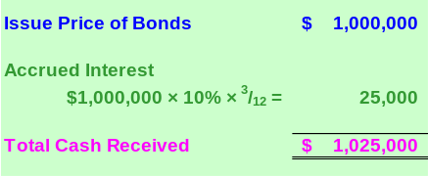
Issuing Bonds Between Interest Dates
How much cash will the company receive for the entire issue of the bonds?

Slide 67

Issuing Bonds Between Interest Dates
What does the $25,000 in accrued interest represent for the company?
Prepare the journal entry to record the bond issue on April 1, 2002.

Slide 68
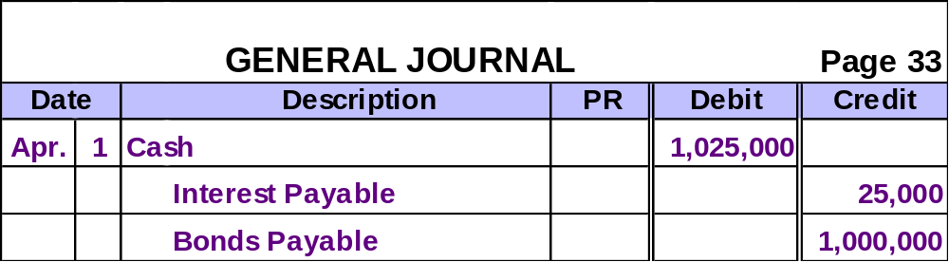
Issuing Bonds Between Interest Dates
Here is the journal entry to record the bond issue on April 1, 2002.
Now, prepare the entry for June 30, 2002.

Slide 69
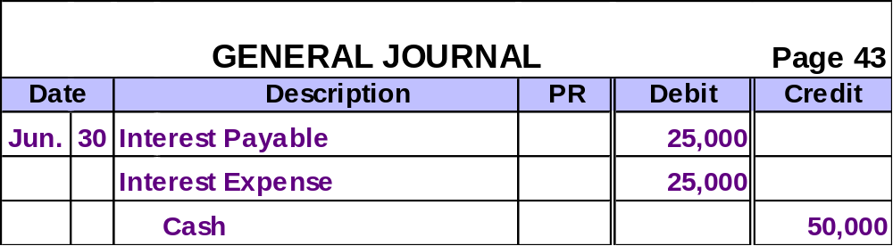
Issuing Bonds Between Interest Dates
Here is the entry to record the interest payment on June 30, 2002.
$1,000,000 × 10% × ½ = $50,000

Slide 70
Accruing Bond Interest Expense
End of accounting period
Interest Payment Dates
Jan. 1
Apr. 1
Oct. 1
Dec. 31
3 months’ accrued interest
At year-end, an adjusting entry is necessary to recognize bond interest expense accrued since the most recent interest payment.

